Slide 1
CPU Scheduling

Slide 2
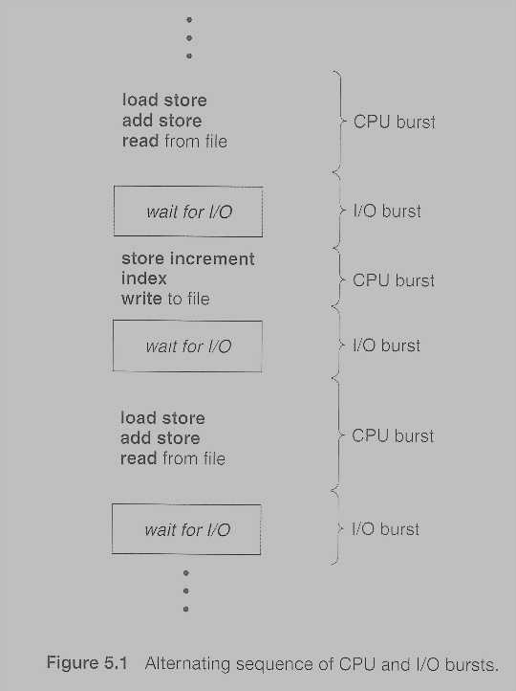
Abraham Silberschatz, Greg Gagne, and Peter Baer Galvin, "Operating System Concepts, Eighth Edition ", Chapter 5
CPU Scheduling

Slide 3
CPU Scheduling
CPU Scheduler
Whenever the CPU becomes idle, it is the job of the CPU Scheduler to select another process from the ready queue to run next.
Processes are not necessarily scheduled as per FIFO strategy only.
Types of Scheduling
1. When a process switches from the running state to the waiting state, such as for an I/O request or invocation of the wait( ) system call.
2. When a process switches from the running state to the ready state, for example in response to an interrupt.
3. When a process switches from the waiting state to the ready state, say at completion of I/O or a return from wait( ).
4. When a process terminates.
For conditions 1 and 4 there is no choice - A new process must be selected.
For conditions 2 and 3 there is a choice - To either continue running the current process, or select a different one.

Slide 4
Scheduling Criteria
CPU utilization - Ideally the CPU would be busy 100% of the time, so as to waste 0 CPU cycles. On a real system CPU usage should range from 40% ( lightly loaded ) to 90% ( heavily loaded. )
Throughput - Number of processes completed per unit time. May range from 10 / second to 1 / hour depending on the specific processes.
Turnaround time - Time required for a particular process to complete, from submission time to completion. ( Wall clock time. )
Waiting time - How much time processes spend in the ready queue waiting their turn to get on the CPU.
( Load average - The average number of processes sitting in the ready queue waiting their turn to get into the CPU. Reported in 1-minute, 5-minute, and 15-minute averages by "uptime" and "who". )
Response time - The time taken in an interactive program from the issuance of a command to the commence of a response to that command.
In general one wants to optimize the average value of a criteria ( Maximize CPU utilization and throughput, and minimize all the others. ) However some times one wants to do something different, such as to minimize the maximum response time.

Slide 5
CPU Scheduling
If scheduling takes place only under conditions 1 and 4, the system is said to be non-preemptive, or cooperative
Otherwise the system is said to be preemptive
non-preemptive scheduling up to Windows 3.x,
pre-emptive scheduling with Win95 onwards
Macs used non-preemptive prior to OSX and pre-emptive since then.
>> Note that pre-emptive scheduling is only possible on hardware that supports a timer interrupt.
Preemption can also be a problem if the kernel is busy implementing a system call.
Problematic for real-time systems, as real-time response can no longer be guaranteed.
Disabling interrupts before entering the critical section and re-enabling interrupts on exiting the section can hamper preemption

Slide 6
Dispatcher
The dispatcher is the module that gives control of the CPU to the process selected by the scheduler. This function involves:
Switching context.
Switching to user mode.
Jumping to the proper location in the newly loaded program.
The dispatcher needs to be as fast as possible, as it is run on every context switch. The time consumed by the dispatcher is known as dispatch latency.

Slide 7
Scheduling Criteria
Batch Systems --- > Throughput
Interactive Systems ---> Proportionality, Quick response time
Real Time Systems --- > Response time
Temperature monitor, Fire detection system

Slide 8
Scheduling Algorithms

Slide 9
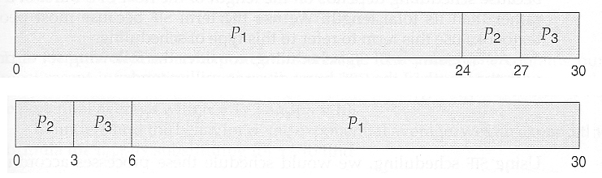
First-Come First-Serve Scheduling, FCFS
In the first Gantt chart below, process P1 arrives first. The average waiting time for the three processes is ( 0 + 24 + 27 ) / 3 = 17.0 ms.
In the second Gantt chart below, the same three processes have an average wait time of ( 0 + 3 + 6 ) / 3 = 3.0 ms. The total run time for the three bursts is the same, but in the second case two of the three finish much quicker, and the other process is only delayed by a short amount.
Process | Burst Time
P1 | 24
P2 | 3
P3 | 3
Average Turn Around Time (ATT) =
Average Waiting time + Average CPU burst time
ATT = 17 + ((24+3+3)/3) = 27ms

Slide 10
First-Come First-Serve Scheduling, FCFS
FCFS Convoy effect
CPU bound jobs will hold CPU until exit or I/O
(but I/O rare for CPU-bound thread)
- long periods where no I/O requests issued, and CPU held
- Result: poor I/O device utilization
FCFS is very simple - Just a FIFO queue, like customers waiting in line at the bank or the post office or at a copying machine.
Unfortunately, however, FCFS can yield some very long average wait times, particularly if the first process to get there takes a long time.

Slide 11
First-Come First-Serve Scheduling, FCFS
CPU Time Arrival Time
P0 5 0
P1 3 1
P2 8 2
P3 6 3
Process Wait Time : Service Time - Arrival Time
P0 0 - 0 = 0
P1 5 - 1 = 4
P2 8 - 2 = 6
P3 16 - 3 = 13
Average Wait Time: (0 + 4 + 6 + 13) / 4 = 5.75

Slide 12

Shortest-Job-First Scheduling, SJF
Pick job with shortest time to execute next
Process | Burst Time
P1 | 6
P2 | 8
P3 | 7
P4 | 3
In the case above the average wait time is ( 0 + 3 + 9 + 16 ) / 4 = 7.0 ms, ( as opposed to 10.25 ms for FCFS for the same processes. )

Slide 13
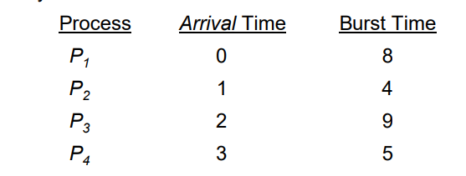
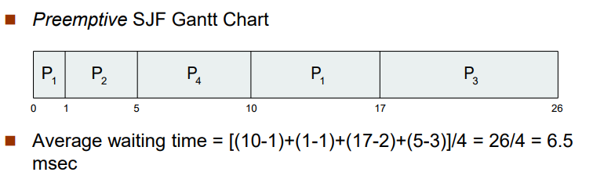

Shortest Remaining Time Next ( SRTN )
Pre-emptive: compare running time of new job to remaining time of existing job
Need to know the run times of jobs in advance

Slide 14
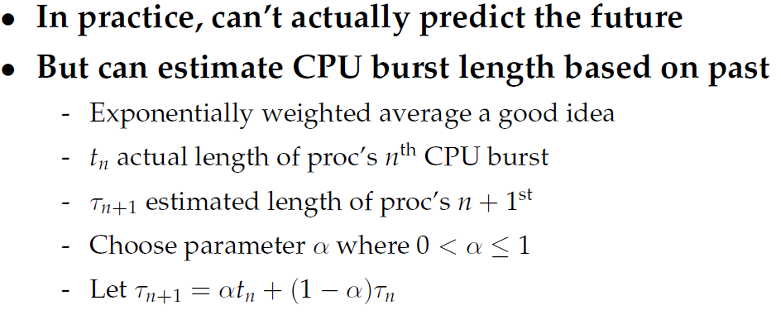
How to estimate CPU burst time ?

Slide 15
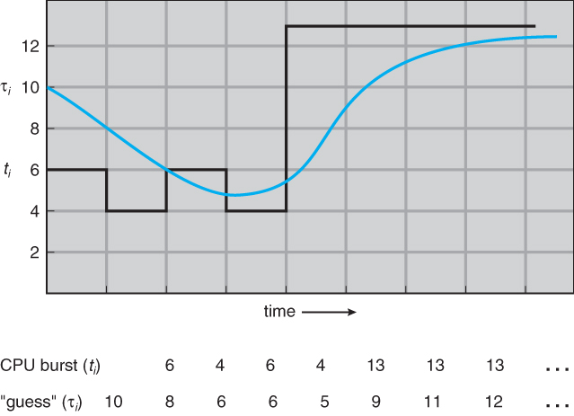
How to estimate CPU burst time ?

Slide 16
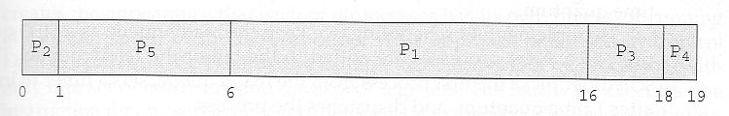
Priority Scheduling
Priorities are implemented using integers within a fixed range, but there is no agreed-upon convention as to whether "high" priorities use large numbers or small numbers. This book uses low number for high priorities, with 0 being the highest possible priority.
Process | Burst Time | Priority
P1 | 10 | 3
P2 | 1 | 1
P3 | 2 | 4
P4 | 1 | 5
P5 | 5 | 2
Average waiting time = (0+1+6+16+18)/5 = 8.2ms

Slide 17
Priority Scheduling
SJF is priority scheduling where priority is the inverse of predicted next CPU burst time
Problem : Starvation – low priority processes may never execute
Solution : Aging – as time progresses increase the priority of the process
Consider a process with priority 127. If we increase its priority by 1 every 15 minutes, then in more than 32 hours the process will age to 0 priority and get executed.
There is a rumor that when the IBM 7094 at MIT was shut down in 1973 that a low-priority process from 1967 had not yet been run.

Slide 18
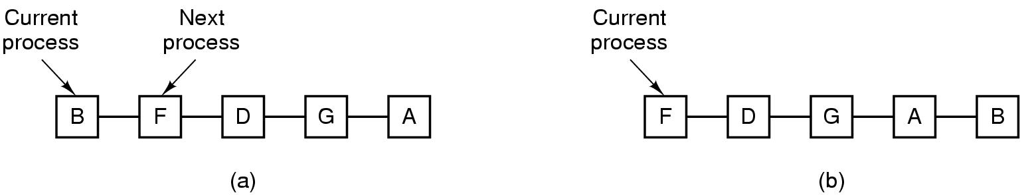
Round Robin (RR) scheduling

Slide 19
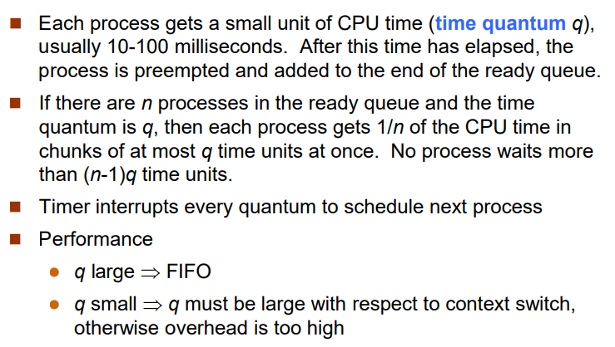
Round Robin (RR)

Slide 20
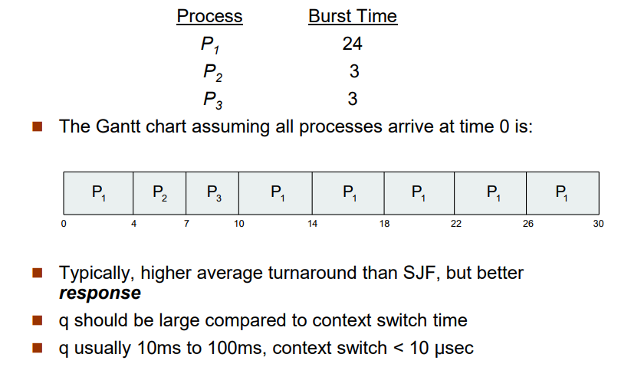
Round Robin (RR)

Slide 21
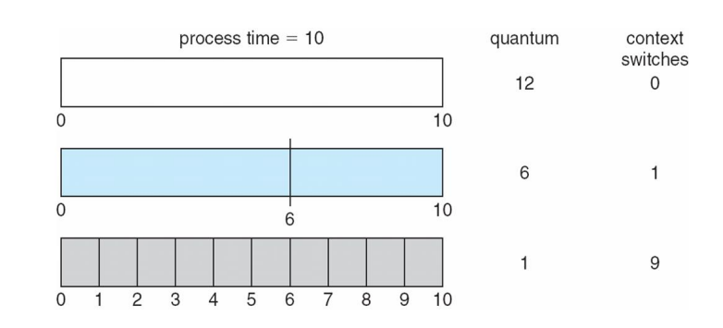
Round Robin (RR)

Slide 22
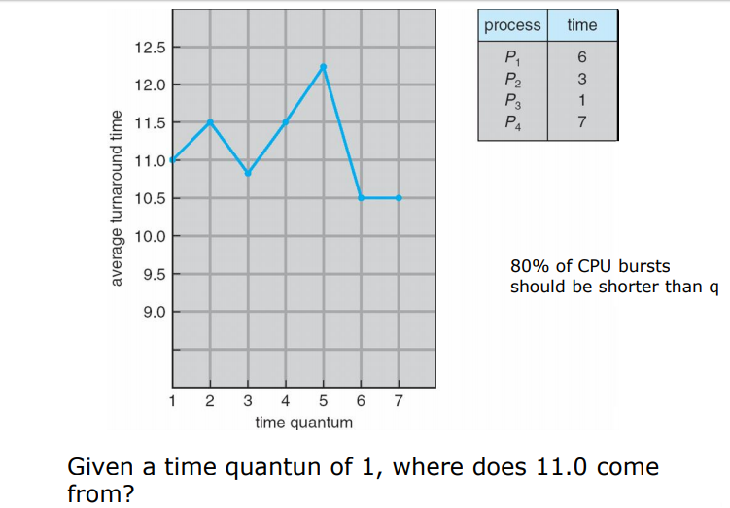
What should be the value of Q?

Slide 23
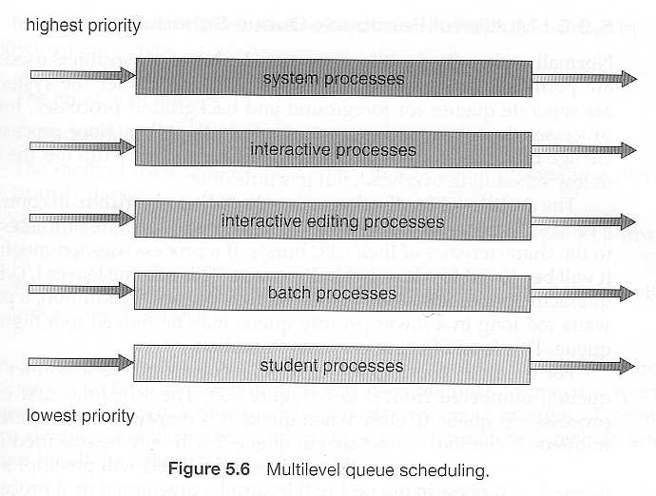
Multilevel Queue Scheduling

Slide 24
Multilevel Queue Scheduling
When processes can be readily categorized, then multiple separate queues can be established, each implementing whatever scheduling algorithm is most appropriate for that type of job, and/or with different parametric adjustments.
Scheduling must also be done between queues, that is scheduling one queue to get time relative to other queues. Two common options are strict priority ( no job in a lower priority queue runs until all higher priority queues are empty ) and round-robin ( each queue gets a time slice in turn, possibly of different sizes. )
Note that under this algorithm jobs cannot switch from queue to queue - Once they are assigned a queue, that is their queue until they finish.

Slide 25
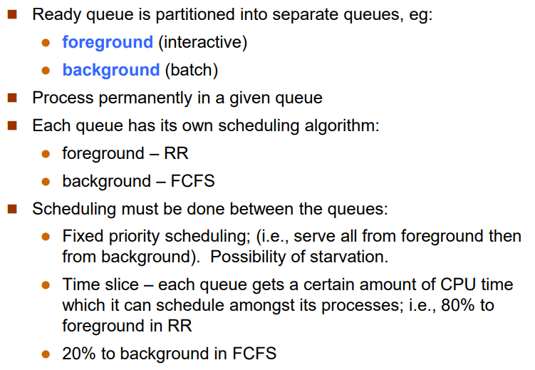
Multilevel Queue Scheduling

Slide 26
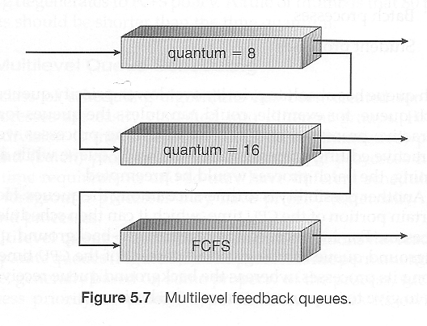
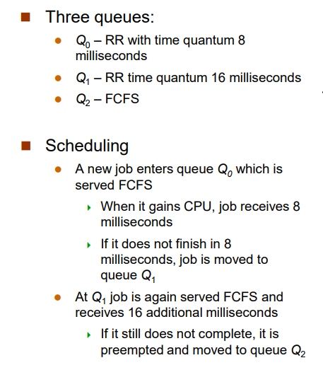
Multilevel Feedback-Queue Scheduling
Multilevel feedback queue scheduling is similar to the ordinary multilevel queue scheduling described above, except jobs may be moved from one queue to another for a variety of reasons
Multilevel feedback queue scheduling is the most flexible, because it can be tuned for any situation. But it is also the most complex to implement

Slide 27
Lottery Scheduling
Hold lottery for cpu time several times a second
Can enforce priorities by allowing more tickets for “more important” processes
Example: Client Server Activity

